Slide 1
Color Blindness
By, Annabelle Pisciotta and Jose Caballero

Slide 2
Names For The Disorder
Medical name:
Color Vision Deficiency
Common Name:
Color Blindness / Colorblind

Slide 3
Type of Disorder
Color blindness is an x-linked recessive disease.

Slide 4
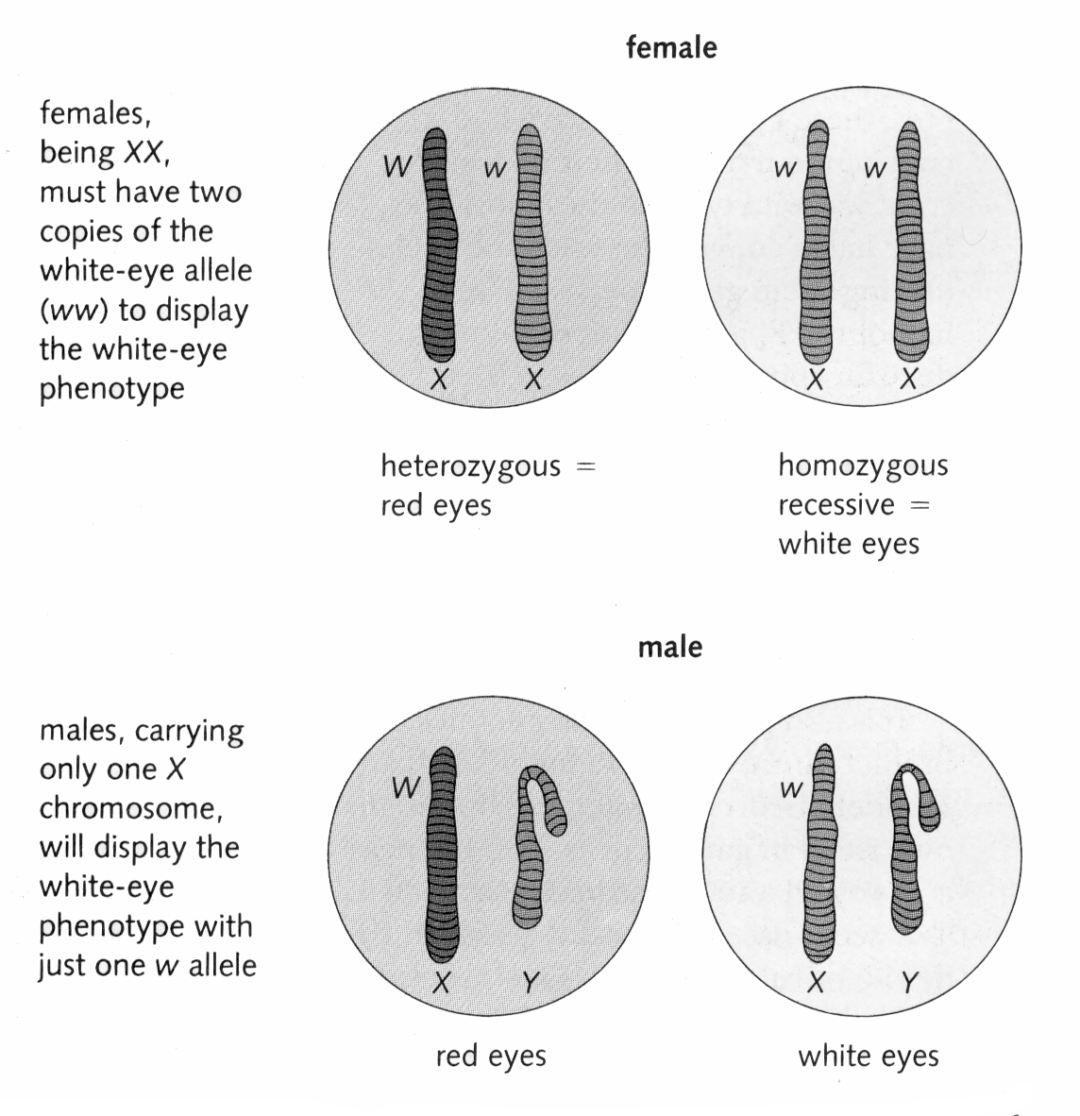

Slide 5
Symptoms of The Disorder
You might See Black, White or Gray (Rare).
You See colors Differently.
Only see few shades of colors.
Can not see some colors.
Example: Can’t see red or green but you can see blue and yellow.

Slide 6
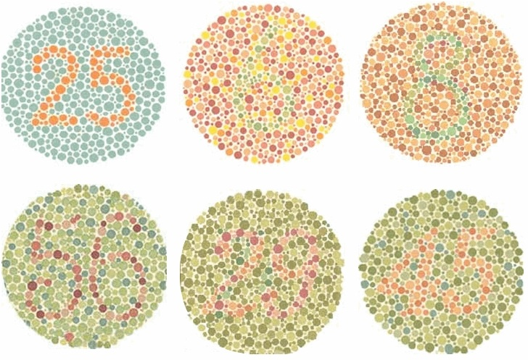
Testing
The testing of the disorder happens usually around the ages of 3 to 5 and is recommended for all children.
Kinds of tests:
One test is they have you place colored chips in order according to how different the color of each chip is to you.
Sets of Colored dots.

Slide 7
Prognosis
Color blindness is not a fatal disease directly
Daily reminders come in the form of being unable to drive, cook meats, or judge how ripe a vegetable or fruit is.

Slide 8
Treatment
There is no treatment for color blindness.
A way to help is to wear glasses that block glare (distinguish better).
Also wearing colored contact lenses helps in seeing the difference between certain colors.
Or as simple as memorizing everyday color patterns.

Slide 9
Genetic Counseling / Punnett Square
 | XN | Y
XN | XN,XN | XN,Y
XN | XN,XN | XN,Y
 | XN | Y
XN | XN,XN | XN,Y
Xn | XN,Xn | Xn,Y
 | Xn | Y
XN | XN,Xn | XN,Y
XN | XN,Xn | XN,Y
 | XN | Y
Xn | XN,Xn | Xn,Y
Xn | XN,Xn | Xn,Y
 | Xn | Y
Xn | Xn,Xn | Xn,Y
Xn | Xn,Xn | Xn,Y

Slide 10
Story/Article
Living With Color Blindness
If you don’t have color blindness, take a moment to think about the many daily tasks that rely on color recognition for ease of completion. How does a red green color blind person tell when their steak is cooked? How much extra thought is involved when driving for a person with Protanopia (cannot see red), who sees the red traffic light as either darkness or pretty much the same as the green one? With more than 7% of males affected by color blindness in some way, it’s highly likely that someone important in your life is affected, so below are some things to be aware of when you’re with that person – you may make a big difference to them by easing their frustration a little if you understand what color blindness can be like.
The topics discussed here are only a few of the many troubles a color blind person can experience whilst living life, for more information on related issues – visit my dangers of color blindness page. On that page you’ll find more real life side-effects and risks of color blindness, and hopefully some sound advice on how to handle your color blindness best!
Color Blindness – Simple Disadvantages
COOKING
As mentioned briefly above, cooking can be a frustrating experience for a color blind individual. Telling when meat is cooked can be next to impossible for a red-green color blind person of even a minor degree. Differentiating between ripe tomatoes and unripened green ones can be tricky, as can identifying ripeness in many other fruit produce. If you’re color blind, I’m sure by now you’ve learnt that sometimes the only way to know is to ask someone else. As far as cooking meats go, you can buy gadgets like steak testers, but for determining the ripeness of produce – it mostly comes down to the eye!
If you’re not color blind, but in a situation where such a person may be cooking with or for you, remember to try to ease their frustration by offering information on how well cooked the meat is, and perhaps even fetch the right tomatoes etc from the fridge for them – it can make a world of difference to the inner frustration us color blind people feel in these situations.
EDUCATION
Choosing colors correctly can be a challenge for students
In primary school, a child will often find themselves coloring in, painting or otherwise involved in various forms of art. It is essential as a parent or teacher to understand that some children with color blindness simply cannot tell they’re coloring in water as purple, instead of blue. Being put down by teachers or mocked by peers can be psychologically damaging to young child, and everything should be done to prevent color blind children from loss of self esteem.
In Secondary school, teens may find themselves in science attempting to identify a chemical reaction or determine a scientific litmus test outcome. As luck would have it, litmus results are often displays of varying shades of purples and greens compared against a reference chart of colors - a recipe for impossibility for most color blind people.
DRIVING
Most color blind individuals can identify between the red and green lights used in modern traffic lights. Those who can’t will usually quickly come to the logical conclusion that they need to check which position on the ‘tree’ of lights is lit, red/Stop is at the top no matter what color it looks! Studies have found that color blind people do have an over-representation in the category of drivers where traffic and hazard lights were involved in the cause of an accident.

Slide 11
Color Blindness Disanvantejes
DRIVING Most color blind individuals can identify between the red and green lights used in modern traffic lights. Those who can’t will usually quickly come to the logical conclusion that they need to check which position on the ‘tree’ of lights is lit, red/Stop is at the top no matter what color it looks! Studies have found that color blind people do have an over-representation in the category of drivers where traffic and hazard lights were involved in the cause of an accident.
Cooking As mentioned briefly above, cooking can be a frustrating experience for a color blind individual. Telling when meat is cooked can be next to impossible for a red-green color blind person of even a minor degree. Differentiating between ripe tomatoes and unripened green ones can be tricky, as can identifying ripeness in many other fruit produce. If you’re color blind, I’m sure by now you’ve learnt that sometimes the only way to know is to ask someone else. As far as cooking meats go, you can buy gadgets like steak testers, but for determining the ripeness of produce – it mostly comes down to the eye! If you’re not color blind, but in a situation where such a person may be cooking with or for you, remember to try to ease their frustration by offering information on how well cooked the meat is, and perhaps even fetch the right tomatoes etc from the fridge for them – it can make a world of difference to the inner frustration us color blind people feel in these situations.
Education In primary school, a child will often find themselves coloring in, painting or otherwise involved in various forms of art. It is essential as a parent or teacher to understand that some children with color blindness simply cannot tell they’re coloring in water as purple, instead of blue. Being put down by teachers or mocked by peers can be psychologically damaging to young child, and everything should be done to prevent color blind children from loss of self esteem. In Secondary school, teens may find themselves in science attempting to identify a chemical reaction or determine a scientific litmus test outcome. As luck would have it, litmus results are often displays of varying shades of purples and greens compared against a reference chart of colors - a recipe for impossibility for most color blind people.

Slide 12
Color Blindness – Career Choices
THE ARTS
Color blindness can make some jobs difficult, and others impossible. Working with fashion and art can be extremely difficult as you will be unable to differentiate between some of the colors you’ll be required to work with as an everyday part of your job. Likewise, jobs such as interior design can be quite challenging.
MILITARY & PLANES
Flying for the Air Force is out of reach for even mildly color blind people
There are some jobs that you simply will not be allowed to have. Some forms of engineering do require the ability to work with colored wiring, and in certain situations the ability to differentiate the wires instantly without assistance is critical – such as in the army. When talking about planes and military, if you are color blind your options are severely limited, you won’t get to be a pilot, a co-pilot or anything else interesting. The only way a color blind person will get a job flying for the defense force is in the back of the plane rigging parachutes etc.
Thankfully, the civilian flying laws are much more relaxed, it’s even possible to be a career pilot flying commercial aircraft if you’re color blind. If flying is your passion - then there are ways to live your dream, but you need to understand that your options are limited, and at this point in time nothing can be done about that – corrective lenses etc are not accepted as sufficient correction in most cases.

Slide 13
Sources
http://www.colour-blindness.com/
http://www.urmc.rochester.edu/encyclopedia/content.aspx?ContentTypeID=1&ContentID=452
http://medical-dictionary.thefreedictionary.com/color+blindness
http://www.webmd.com/eye-health/tc/color-blindness-topic-overview?page=2
http://www.colour-blindness.com/solutions/living-with-colour-blindness/

